Slide 1
Enterprise Apps & Agents
POWER PLATFORM
Enterprise Code App → Dataverse → AI Builder → Copilot Studio Agent → Governed Automation → Capstone Project

Slide 2
Parent-child and connected-agent patterns
Parent-child (child agents)
Connected agents
A child agent lives inside the parent agent's solution. The parent routes to it and shares its settings. Best for one team owning a tightly coupled workflow.
An independent agent, published and owned separately, is called by another agent. Best for reuse across teams, separate release cycles and clear ownership.
Choose parent-child when
Choose connected when
One owner, one release, shared knowledge and shared tools, and you want simple setup.
Different owners, different environments or security boundaries, or a skill reused by many agents.
01 | Agent patterns
Notes:
Rule of thumb: start with one agent, add child agents for focus, use connected agents for reuse and ownership boundaries.

Slide 3
Delegation, orchestration and decomposition decisions
1. Decompose
2. Delegate
3. Orchestrate
Split by distinct skill, data domain or permission level. If an agent needs more than a few unrelated tools, split it.
The orchestrator reads each agent's name and description to route. Write them as clear, non-overlapping job statements.
Decide who owns the conversation, what is passed down, and what result comes back. Keep one accountable orchestrator.
Avoid
Test
Too many tiny agents, deep chains, overlapping descriptions and circular delegation. Each hop adds latency, cost and failure points.
Build routing test sets: for each prompt, which agent should answer? Re-run after any description change.
02 | Decisions
Notes:
Decomposition is a design decision, not a goal. More agents means more governance surface.

Slide 4
Shared versus per-agent context and long-running interactions
Approach | Benefit | Risk
Shared context | Continuity; no repeated questions | Over-sharing sensitive data
Per-agent context | Isolation, least data, easier testing | Must pass key facts explicitly
Pass only what is needed
Long-running work
Handle failure
Send explicit inputs (customer ID, intent, constraints) instead of the full transcript.
Use flows with approvals or callbacks, store state in Dataverse, and resume with a correlation ID.
Plan for timeouts, retries and hand-back: the child returns status, result and any follow-up needed.
03 | Context and state
Notes:
Default to per-agent context and share deliberately. Persisted state belongs in a governed store, not the chat.

Slide 5
Agent2Agent and Model Context Protocol integration
MCP: agent to tools
A2A: agent to agent
An open standard for exposing tools, resources and prompts to agents. An MCP server publishes capabilities; the agent discovers and calls them.
An open protocol for agents from different vendors or platforms to discover each other, exchange tasks and return results.
In practice: add MCP servers as tools in Copilot Studio, and use A2A to reach agents outside your tenant or platform. Treat both as external integrations that need approval, authentication and DLP review.
04 | Open protocols
Notes:
Think of MCP as the USB port for tools and A2A as the handshake between agents. Check current Copilot Studio documentation for supported features.

Slide 6
Authentication, authorization, least privilege, connectors and DLP
Authentication
Authorization
Use Microsoft Entra ID. Choose user (delegated) or maker/service identity per tool, deliberately and per action.
Enforce permissions at the data source: Dataverse security roles, Graph scopes, API roles. Never rely on the prompt.
Least privilege
Connectors and DLP
Give each agent only the tools and scopes it needs. Use dedicated service accounts and rotate secrets.
Classify connectors as business, non-business or blocked. Restrict custom connectors and MCP endpoints by policy.
05 | Security
Notes:
A child or connected agent should never gain permissions the caller does not have, unless it is explicitly designed and reviewed.

Slide 7
Data Loss Prevention Policies
1
  DLP policies can belong to two different scopes: Environment and tenant.
  When creating a new DLP policy, policy authors have a few options that they can choose from, including the ability to add all environments (tenant), add multiple environments, and exclude certain environments.
2
3
  Environments can have multiple DLP policies applied.
4
  Configuring DLP policies depends on an organization’s design and cyber security principles.

Slide 8
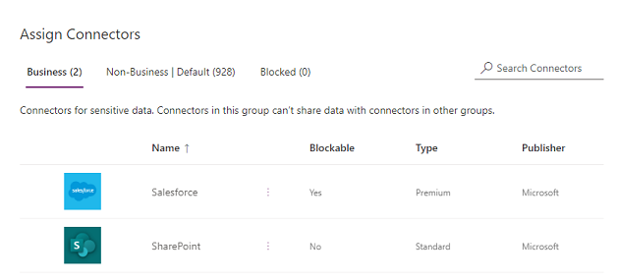
Categorizing Connectors
Business – Connectors for business-sensitive data. Connectors in this group can’t share data with connectors in other groups
Non-Business/Default – Connectors for non-business data, such as personal use data. Connectors in this group can’t share data with connectors in other groups
Blocked – Blocked connectors can’t be used where this policy is applied

Slide 9
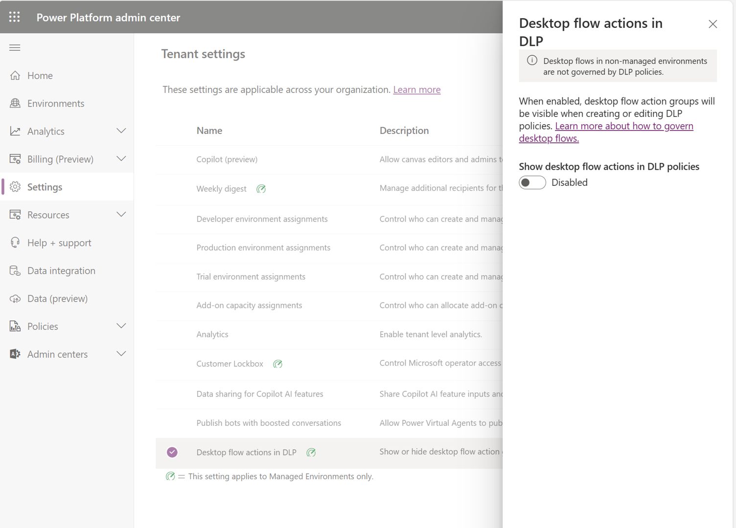
Enable/Disable Desktop Flow DLP
By default, desktop flow action groups don’t appear when creating a new DLP policy
You need to turn on the Desktop flows actions in DLP setting from the Tenant settings

Slide 10
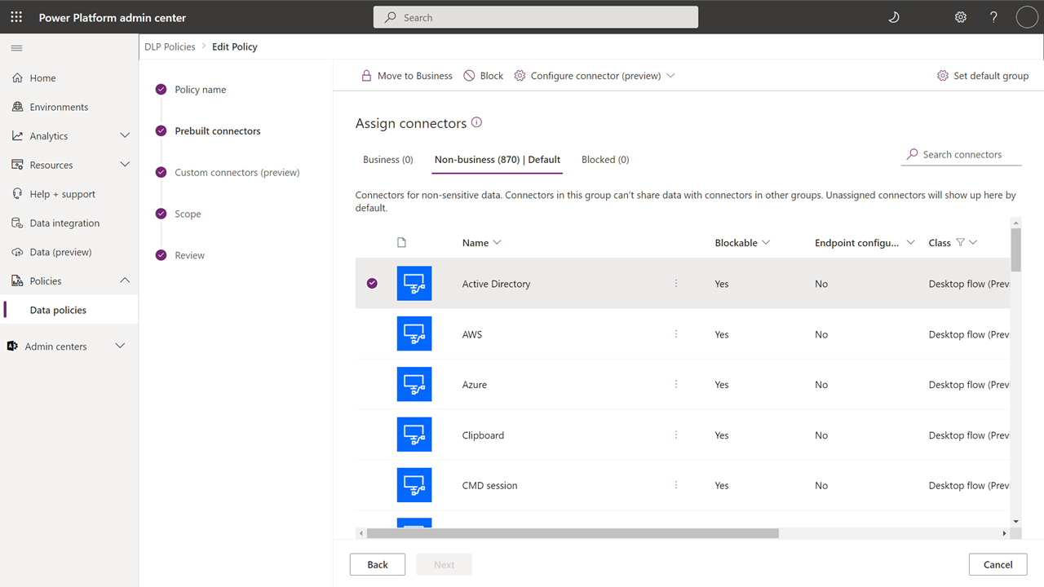
Create a DLP Policy with Desktop Flows Restrictions
Administrators automatically see the new desktop flow modules in the default data group of the DLP policy they’re creating or updating
Policy is suspended if the default group is set to blocked and the desktop flows are running in the target environments

Slide 11
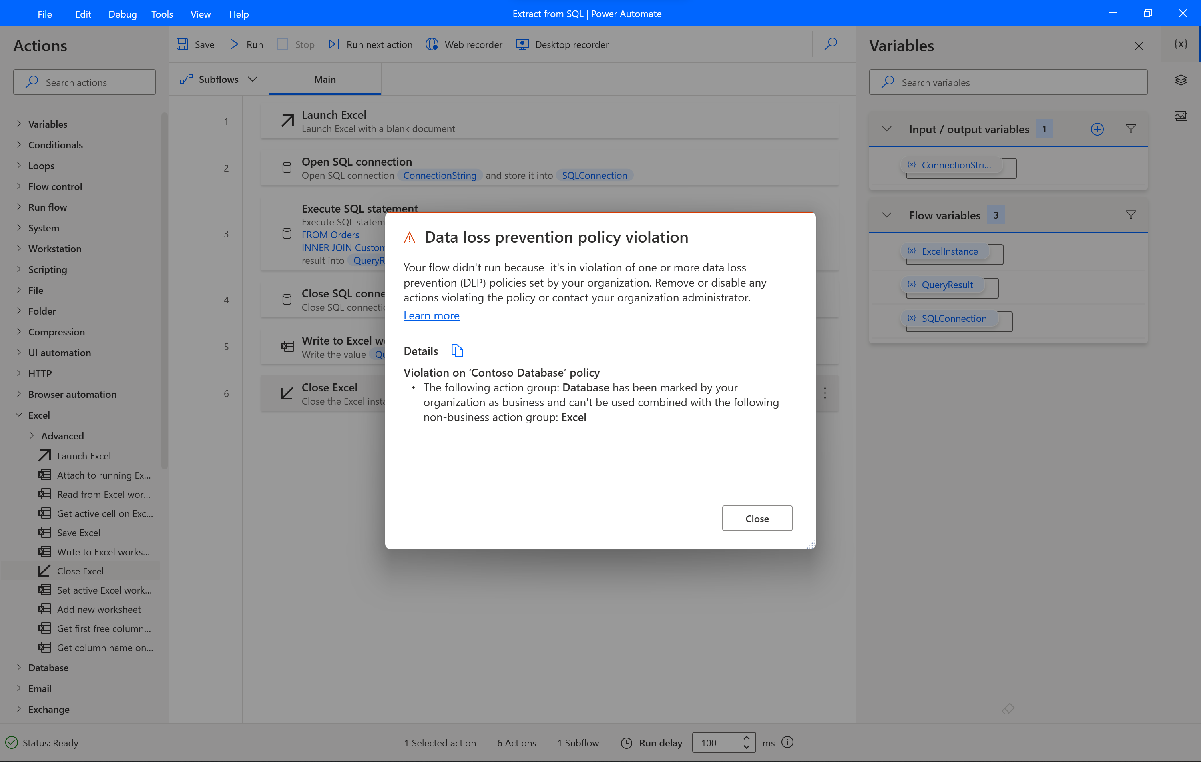
Data Loss Prevention Policy Violations
The business vs non-business data loss prevention policy, prevents users to use actions from the two categories on the same flow
Notes:
For example, the flow that appears below contains the Open SQL connection, Execute SQL statement and Close SQL connection actions which belong to the Database actions group and the Launch Excel, Write to Excel and Close Excel actions that belongs to the Excel actions group. Thus it receives an error as the Database group of actions are marked as business while the Excel group is marked as non-business

Slide 12
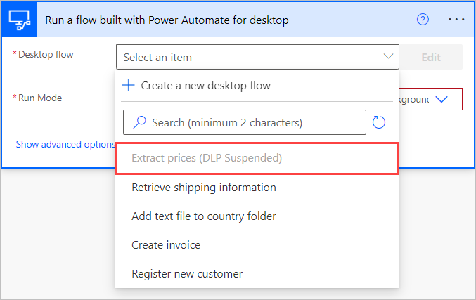
Suspended Desktop Flows in Cloud Flows
A suspended desktop flows due to data loss prevention (DLP) prevention policies violations won’t be available to be selected
To be able to launch the desktop flow from a cloud flow, edit the desktop flow in the desktop designer and resolve the DLP violations

Slide 13
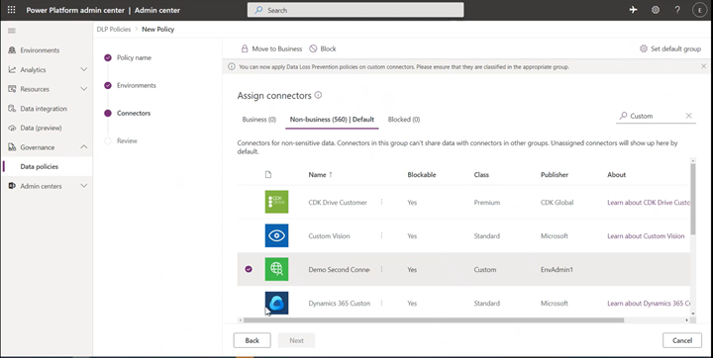
DLP for Custom Connectors
You can manage custom connectors for tenant and environment level data loss prevention (DLP) policies
Environment admins can see all custom connectors alongside of pre-built connectors in the Connectors tab of the Data Policies wizard
Tenant admins will see a new tab in the Data Policies wizard called Custom connectors, which will allow them to specify an ordered list of Allow and Deny URL patterns for custom connectors
Notes:
Custom connectors that are not explicitly classified will be put under the default group (or Non-business if no default group setting is chosen by admins explicitly)

Slide 14
Environments, monitoring and incident response
Dev
Test
Production
Makers build in a dev environment with sample data, using solutions for every component.
Run routing tests, security checks and approvals. Use environment variables and connection references.
Managed solutions only, pipeline deployment, restricted maker access.
Monitor
Respond
Track errors, routing accuracy, latency, cost and tool usage with analytics and Application Insights.
Define owners and runbooks: disable the agent or a tool, revoke credentials, review logs and audit, then fix and redeploy.
06 | Operations
Notes:
Governance is continuous: deploy through pipelines, observe in production, and rehearse the incident process.

Slide 15
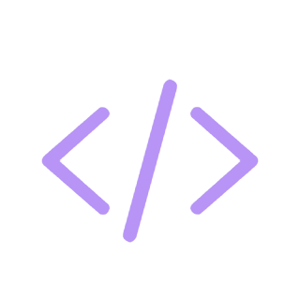
Demo
POWER PLATFORM
H1. Banking: connected servicing agents with delegation
H2. Finance: connect an enterprise system via MCP
H3. Healthcare: configure DLP, authentication and monitoring
Notes:
Welcome. This deck walks through what you need before building your first Power Apps Code App, then the six commands that take you from a starter template to a deployed app.

Slide 16
Closing slide
Thank you

